Slide 1

Disclaimer
This presentation may contain privileged or confidential information intended solely for the use of the individual or entity to whom it is addressed. If you are not the intended recipient, any dissemination, distribution, or copying of this presentation is strictly prohibited. Please notify the sender immediately and delete this presentation from your system. The views and opinions expressed herein are those of the author and do not necessarily reflect the official policy or position of SuiteLabs. Thank you for your cooperation.

Slide 2







Customers

Slide 3
Consulting & Development
eCommerce functional and technical consulting
Help NetSuite users on activities related to website administration and management. Improve and automate repetitive tasks, seeking for an improved user productivity.
Amplify website functionalities
Amplify functionalities of the website by implementing vertical solutions that enhance user experience.
Implementation of Custom Solutions
Understand the specific business needs looking for the optimal solution, giving administrators an easy way to manage it and end users the best shopping experience.
Resolution of functional issues
Find the root cause of the issue, giving immediate solutions to it. Recommend improvements that can be applied to the site looking to minimize future instances of related issues.
General SuiteCommerce Audit
Analyze the site from multiple perspectives looking for ways to improve the performance, shopping experience, shopping flow, etc.

Slide 4
Growth & SEO
Search engine optimization (SEO)
Analyze current situation & define an SEO Growth strategy tailored for SuiteCommerce and its capabilities.
Conversion Rate Optimization
Optimize the conversion rate of the site, oriented to improving ther user experience and increasing the ratio of visitors that turns into buyers.
Growth Marketing
Consulting oriented to Growth by utilizing tailored digital marketing strategies for SuiteCommerce.
Pay Per Click
Strategic Consulting oriented to improving current results, or coming up with new strategies
Tracking Tools & Third Parties
Understand the specific business needs looking for the optimal solution, giving administrators an easy way to manage it and end users the best shopping experience.
Product Feeds
Creation, optimization and maintenance of Product Feeds for Google, Facebook, and any other platform

Slide 5
Shopify Proposal
Online store with several features
Easy to configure and Customize

Slide 6
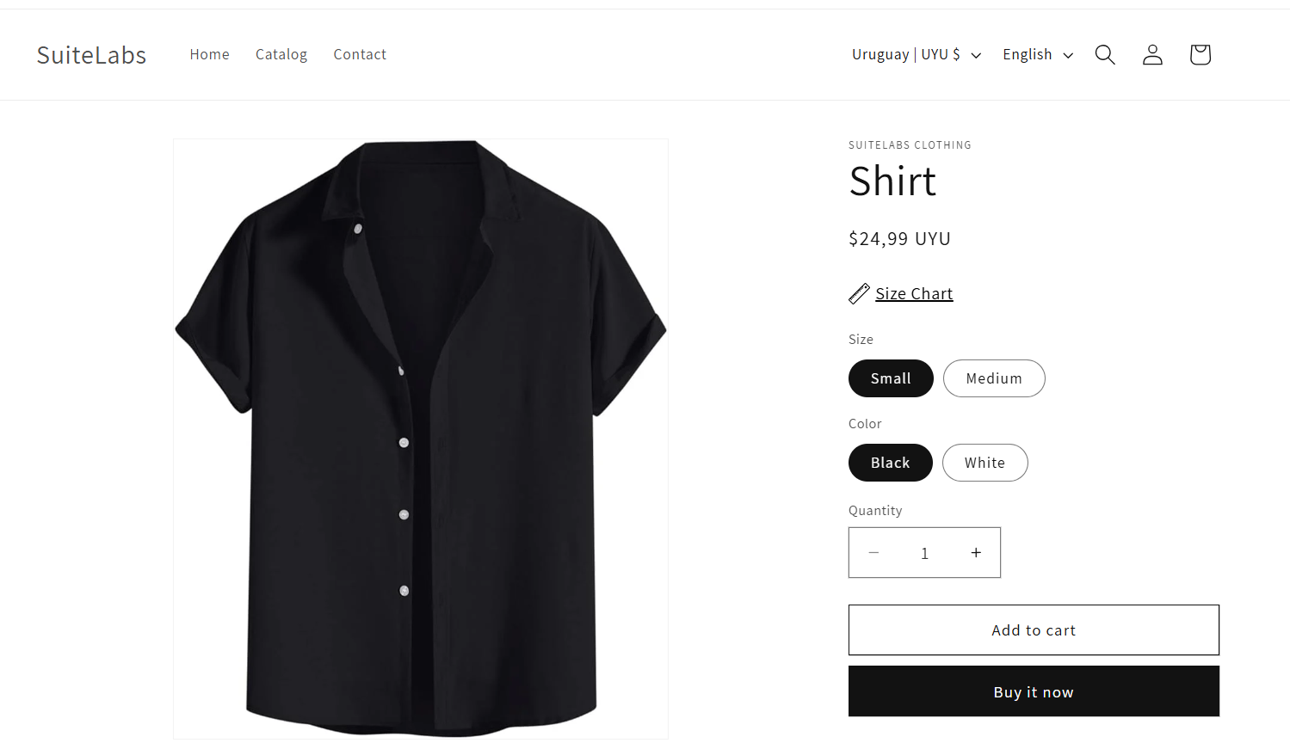
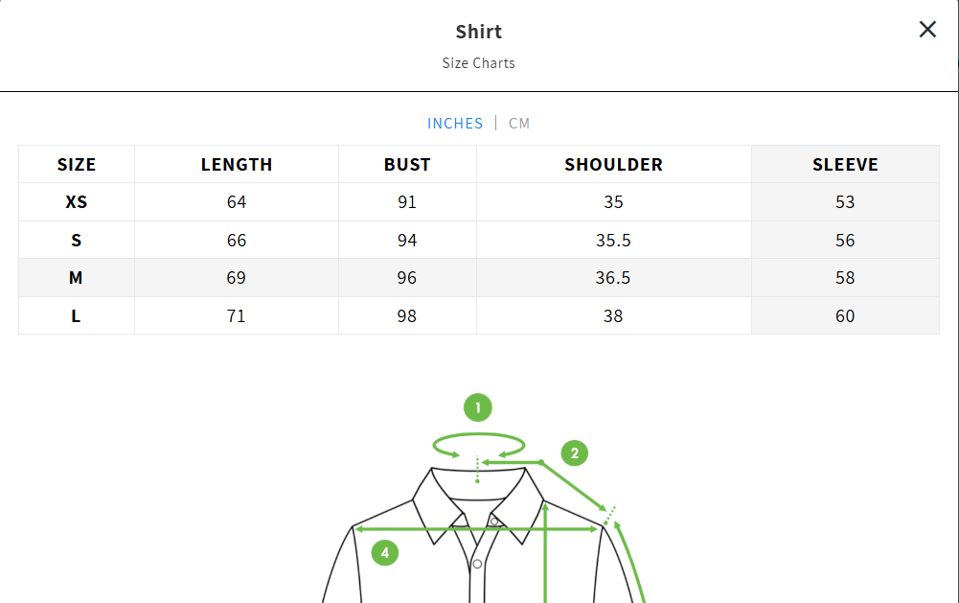
Products
Kiwi size chart integration tool:
Open “size chart” button.
Will show a table with different measures for this product. See xample below:

Slide 7
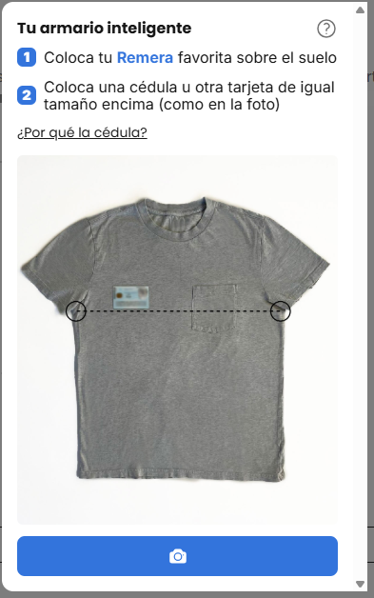
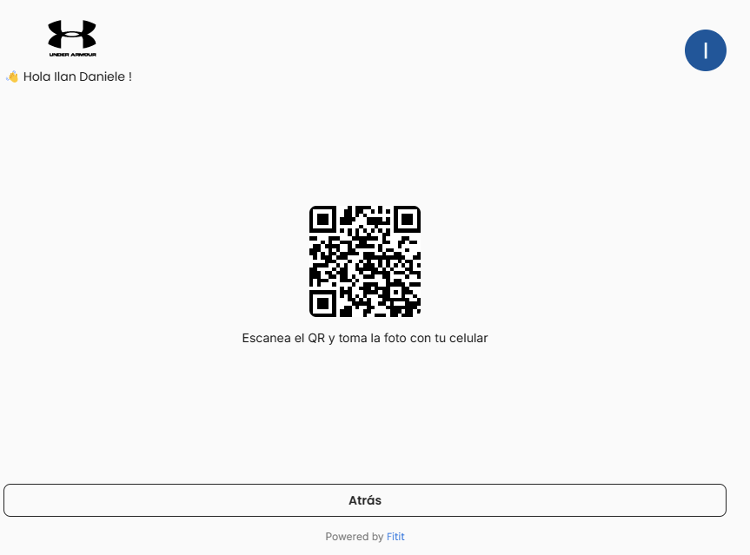
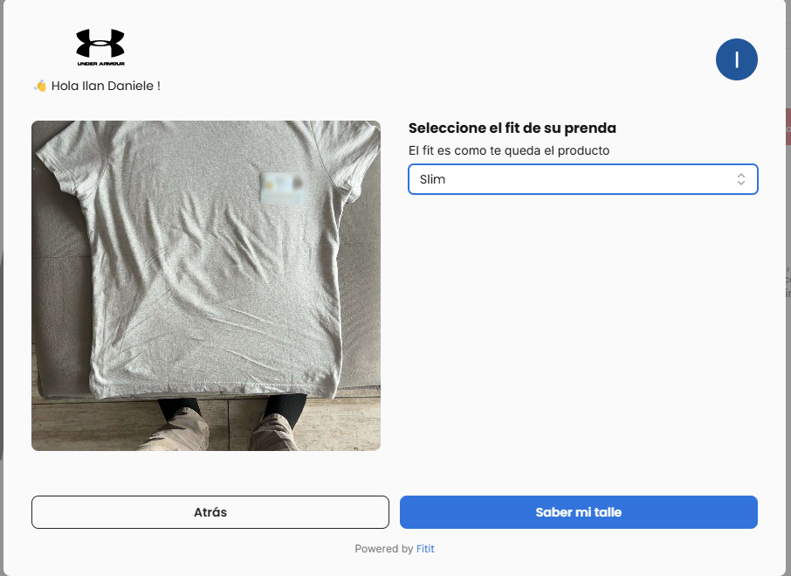
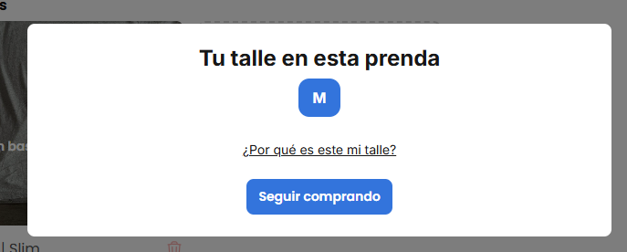
Returns Issue Solution
Measure your body size and know if product fits you with the following native integrations for Shopify
Fitit AI:
Take a photo from one cloth of your own of the same type you are trying to buy with an ID
Select how the product fits you: regular, slim, oversized or cropped.
Will give back the measure that fits you

Slide 8
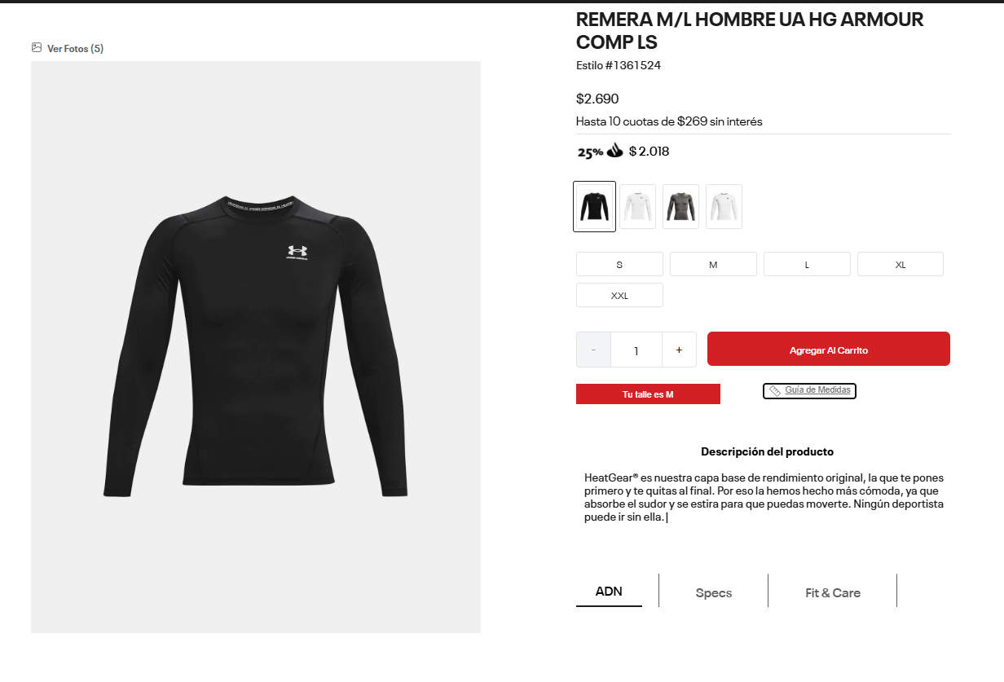
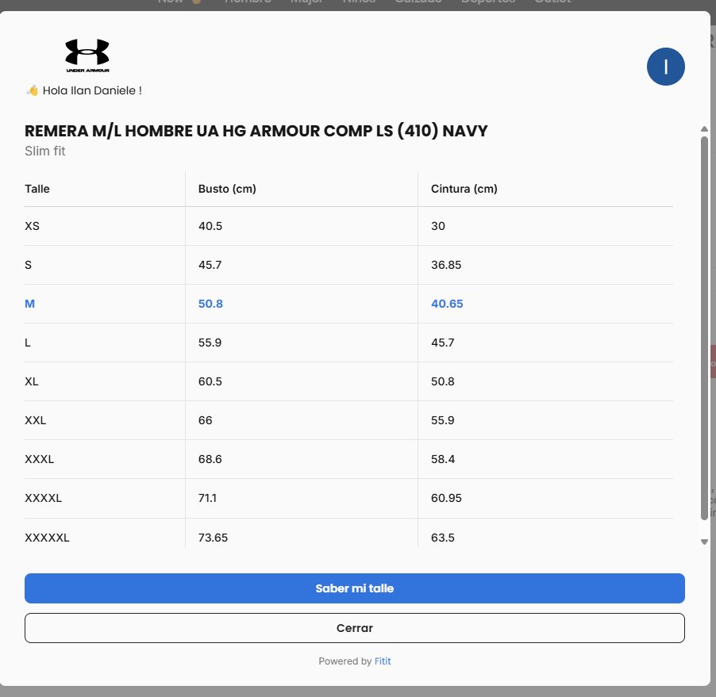
Fifit AI
More features
Also comes with a Size table measurement option
Costs
Costs: starting from 500 USD per site for initial amount of request, up to 2500 (or more) if it’s 1.000.000 requests.
Which becomes a little bit expensive

Slide 9
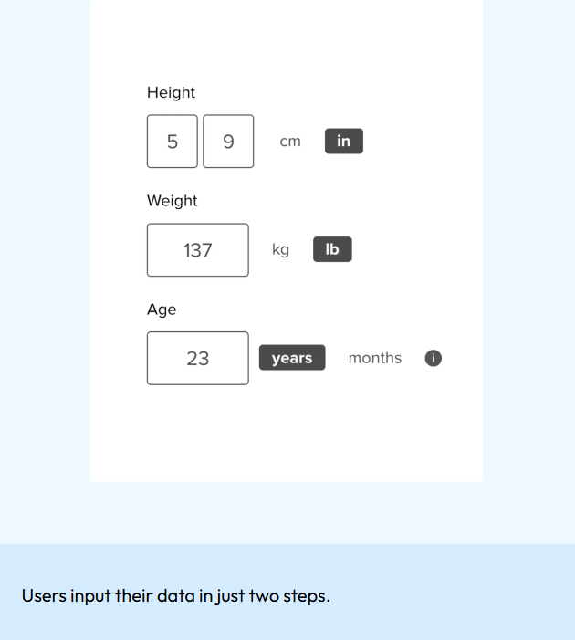
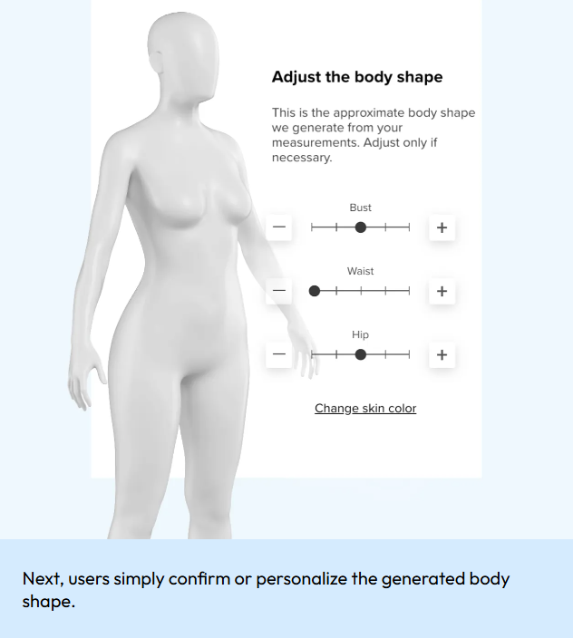
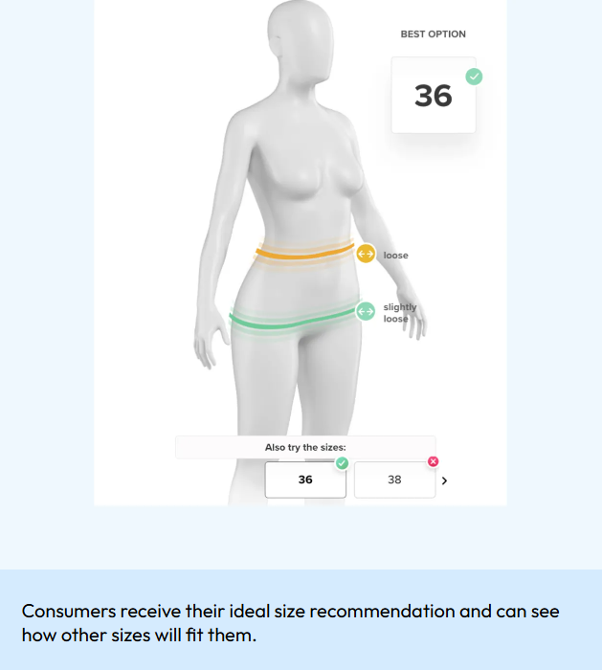
Returns Issue solution
Size bay:
Set your height, body weight and years
Adjust bust, waist and hip

Slide 10
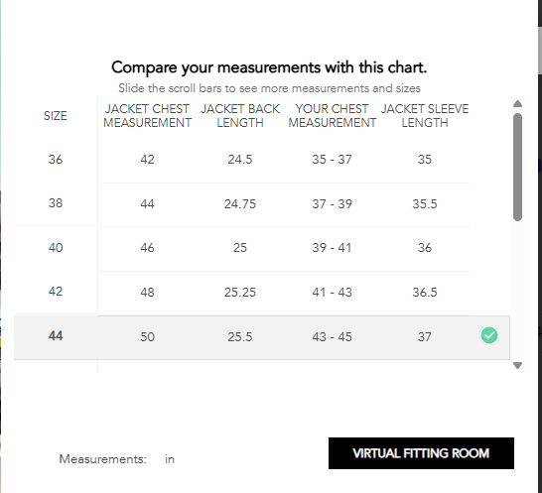
Size bay
More features:
Also foot measurement for footwear.
Users enter the brand of footwear they usually wear and the type of footwear they wear most.
With this information, the tool understands the shape of the user's foot, be it narrow, regular or wide.
Next, the user enters their size which is cross referenced with product measurements to generate size recommendations.
Measurements table also available (see picture)

Slide 11
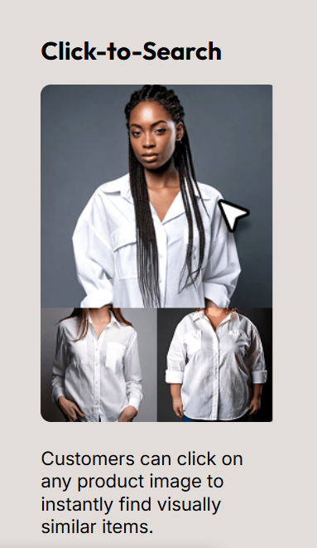
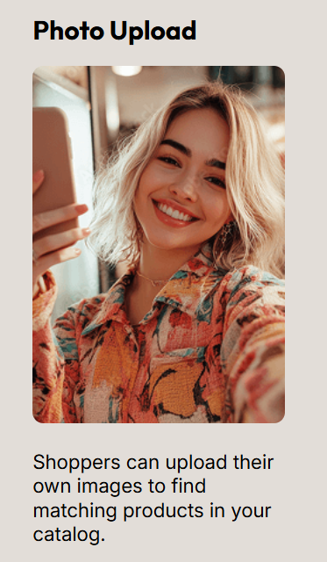
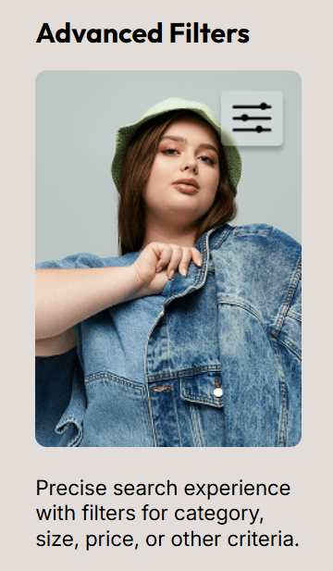
Size Bay
Another feature:
Users can upload photos of their outfits to find products with same patterns, colors textures and styles
Costs:
Initial plan of 400 orders and 80000 pageviews with cost of 160 USD for setup and 116 monthly.

Slide 12
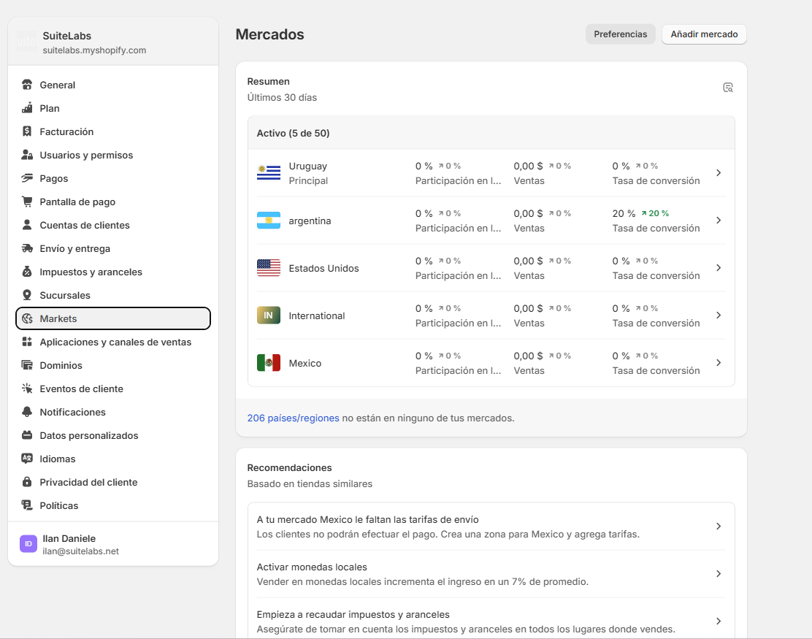
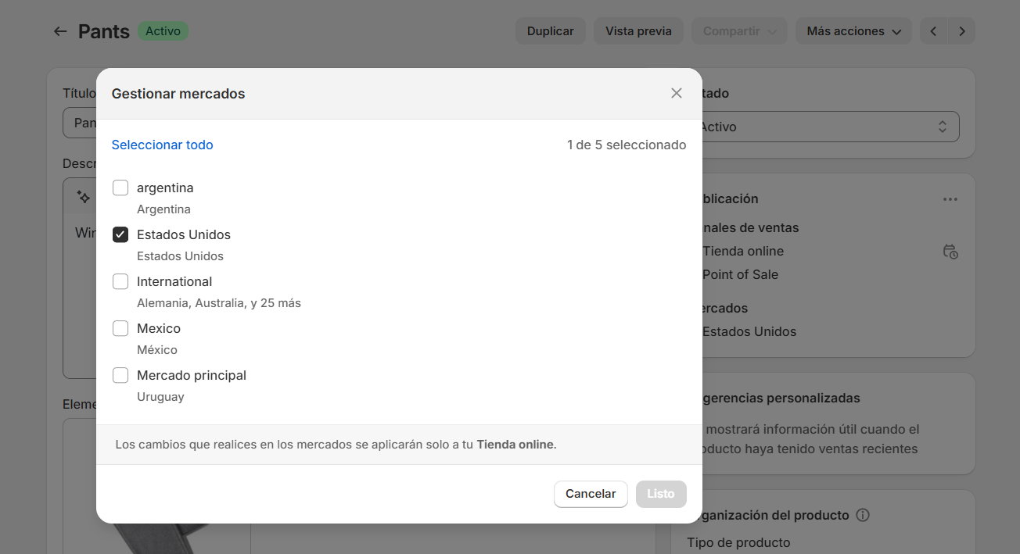
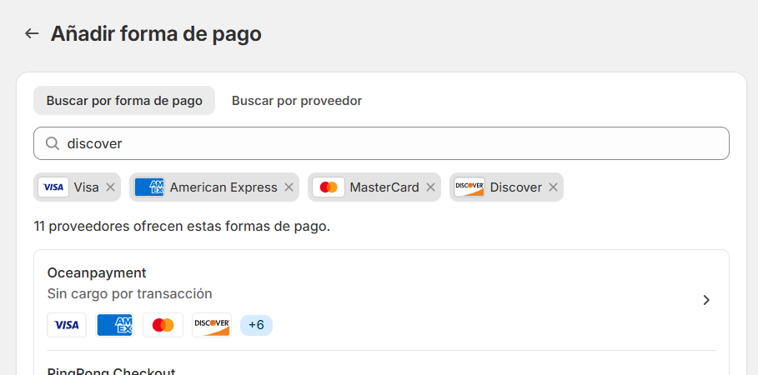
Markets management
Option to add several markets
Select to which markets an specific product will be available
Different taxes can be defined for each of the markets by product.
Different payment methods can be defined (see picture below)
As an example, you can use “Pants” product which is only available in USA

Slide 13
Markets management
Option to add several markets
Select to which markets an specific product will be available
Different taxes can be defined for each of the markets by product.
Different payment methods can be defined (see picture below)
As an example, you can use “Pants” product which is only available in USA

Slide 14
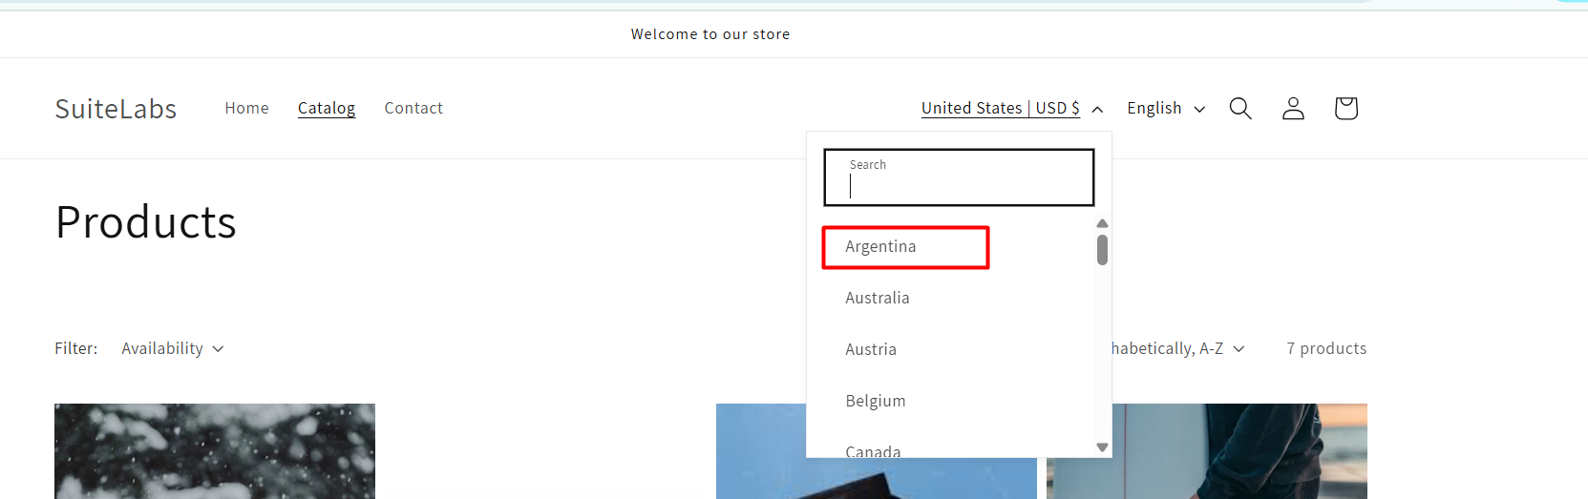
Markets management
Note
On our sandbox store page you can select the market where you want to buy from

Slide 15
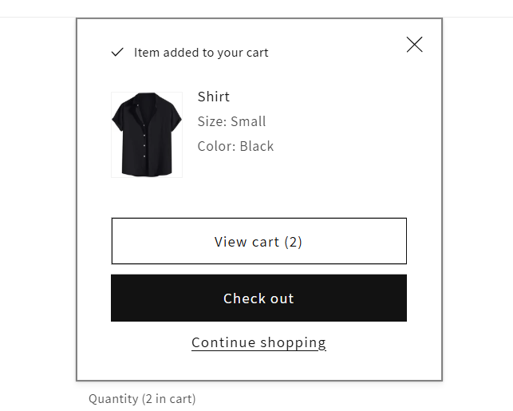
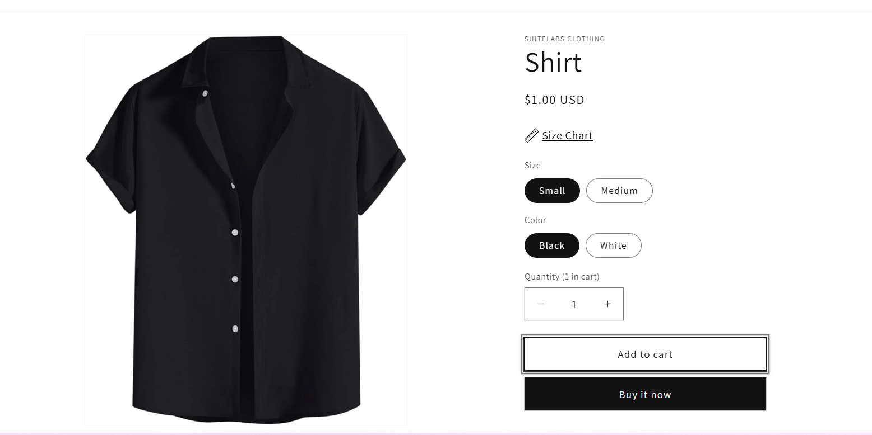
Checkout flow
Steps:
1. “Add to cart” which will add the current selected product with its variants to the cart or “Buy it now” option which will take you straight to the checkout

Slide 16
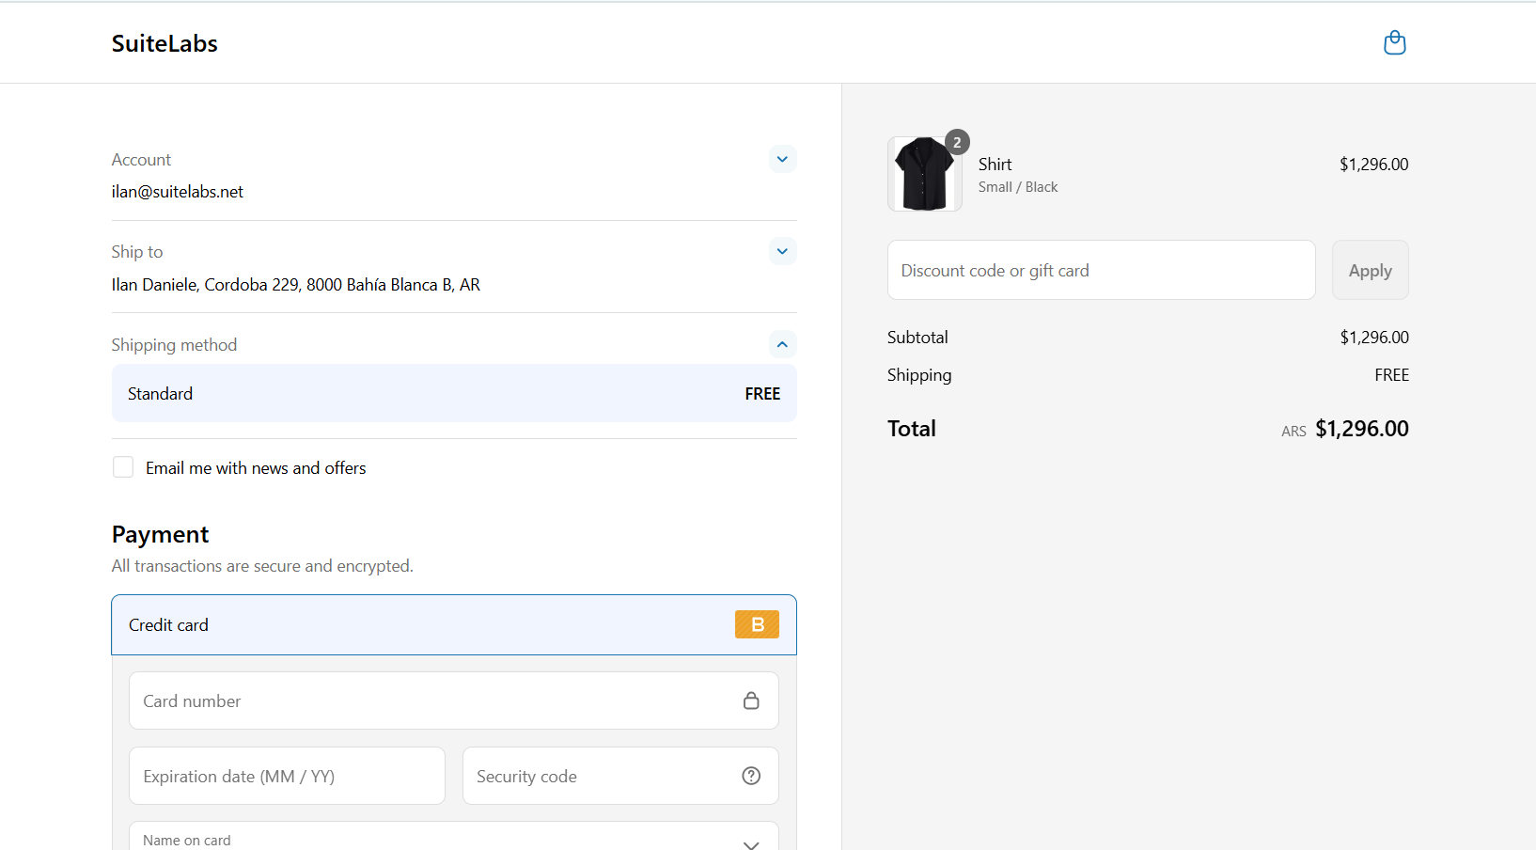
Checkout flow
Steps:
2. Fill in transaction details and payment section
Card number set: 1 (means successfull transaction on bogus)
Expiration date: +1 month from today’s date
Security Code: 33
Notes:
Allows you to select different shipping methods defined in Configuration
Payment to select can be customized (In this case we use bogus as a bypass method to test)

Slide 17
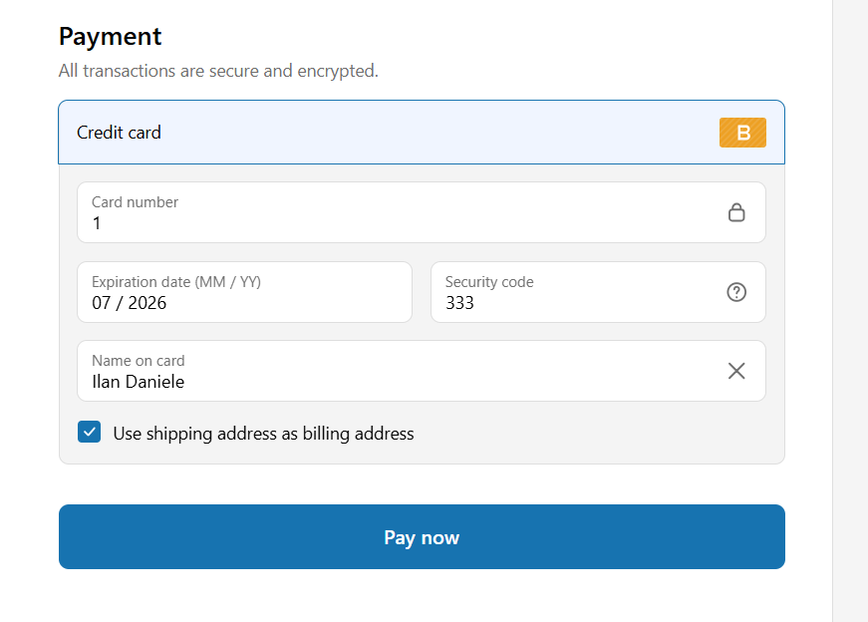
Checkout flow
Steps:
3. Select Pay now

Slide 18
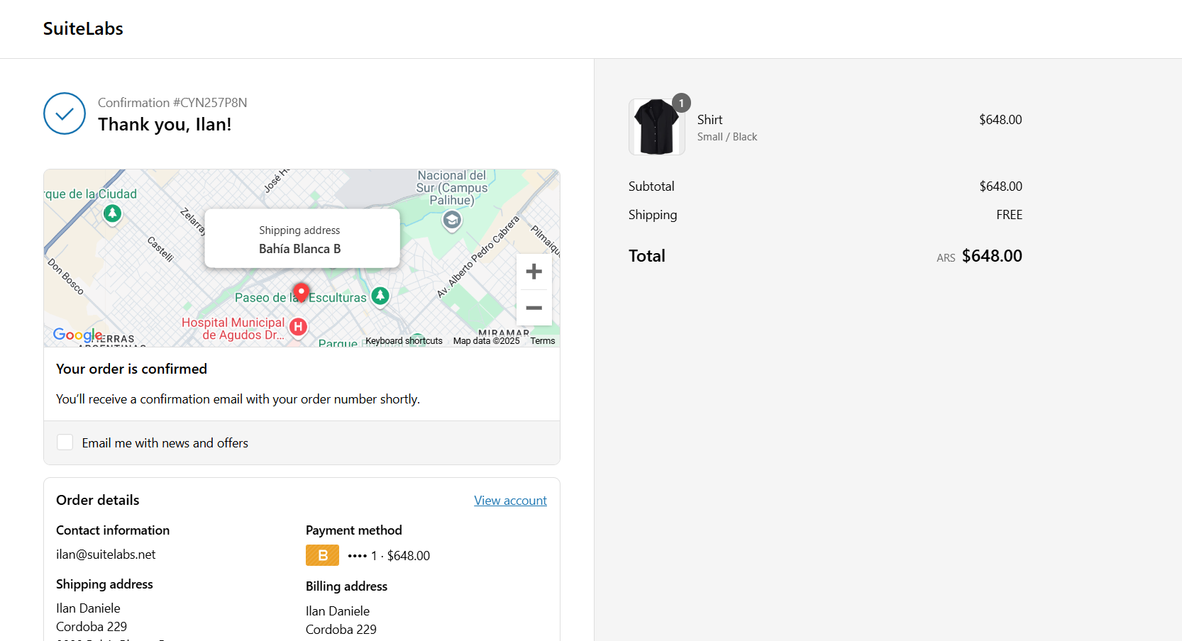
Checkout flow
Confirmation page:
This will show you the order
You will receive an email with all the information

Slide 19
Checkout flow
Steps:
3. Select Pay now

Slide 20
Checkout flow
Important notes:
Use Bogus payment just as example
Payment methods defined previously in different markets will be available

Slide 21
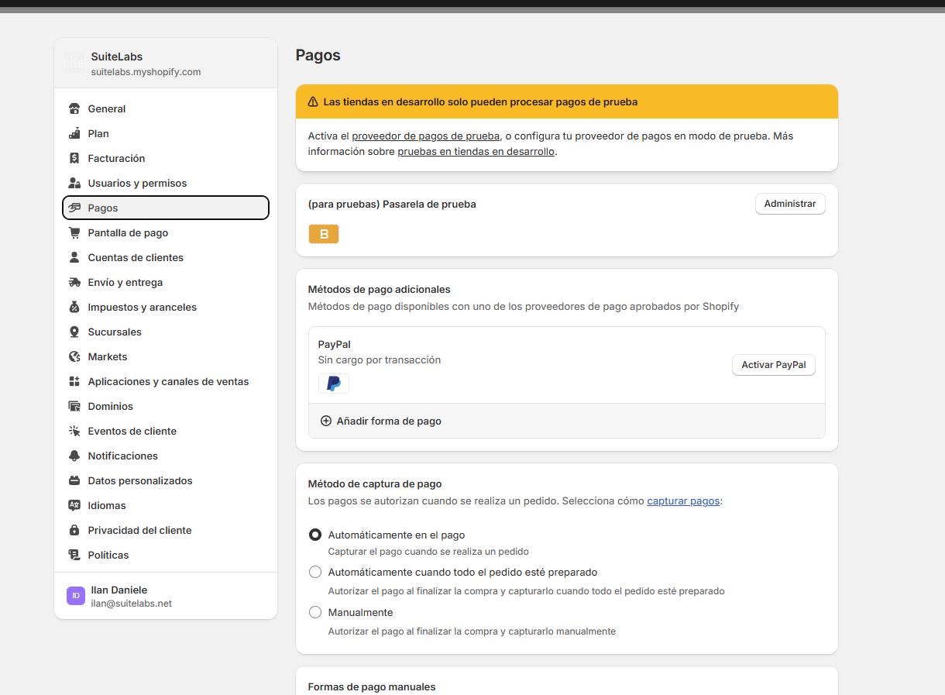
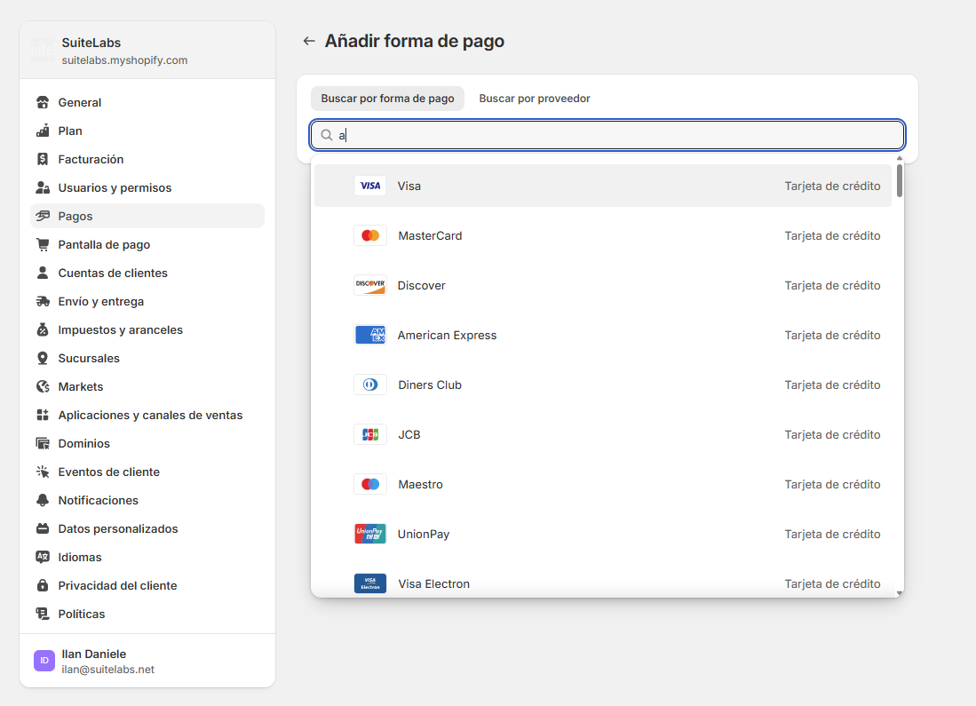
Payment methods
You can add multiple payment methods
Cards: Visa, MasterCard, Discover, American Express, etc.
PayPal.
Also Cryptocurrencies (Binance USD).

Slide 22
Multilanguage
Important notes:
Multiple languages can be installed on our site.
To access them, simply add “/es”, or “/en”, or the one corresponding abbreviation in each language.

